Slide 1
Exploring the Income Dataset
Manthan Desai

Slide 2
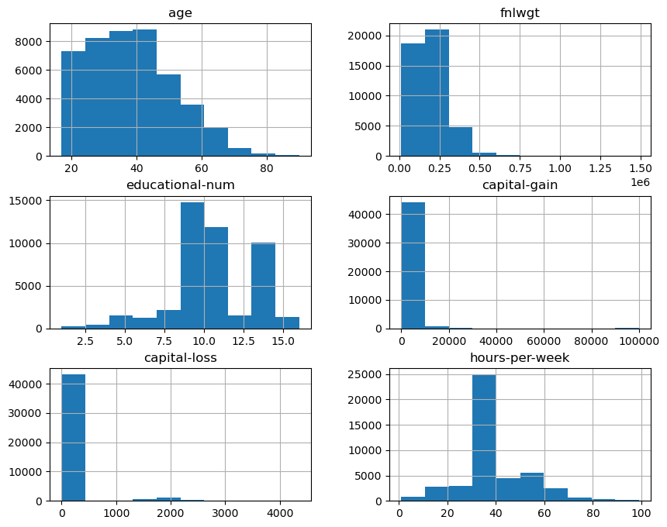
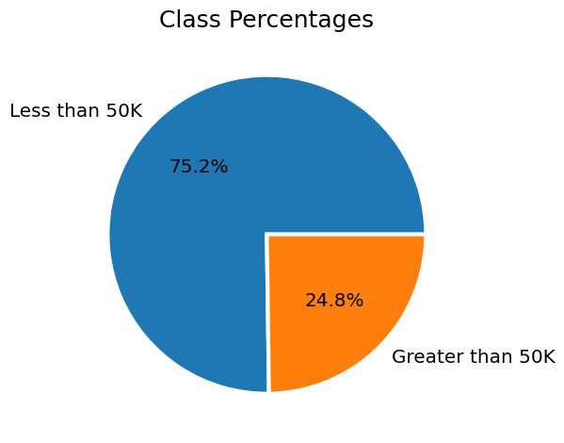
Data Distribution

Slide 3
Hypothesis: Income inequality is influenced by a combination of race, age, and gender, specific demographic groups, such as racial minorities, younger individuals, and women, are more likely to experience lower income levels relative to their counterparts in other demographic categories.

Slide 4
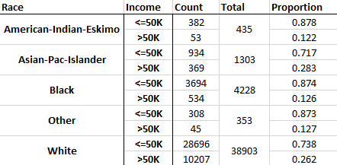
Income distribution by Race
Only about 12% of people with Black or American Indian ethnicity made greater than 50K compared to 26% of people with White and 28% of people with Asian Ethnicity.

Slide 5
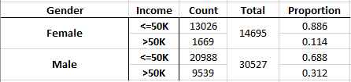
Income distribution by Gender
There is a significant difference in the proportion of women making more than 50K (0.11) compared to the proportion of men making more than 50K (0.312).

Slide 6
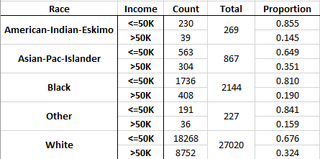
Income distribution by Race for Males
About 19% of males with Black and 14% of males with American Indian ethnicity made greater than 50K compared to 32% of males with White and 35% of people with Asian Ethnicity.

Slide 7
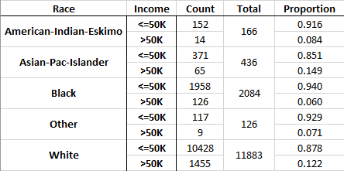
Income distribution by Race for Females
About 6% of black women and 8% of American Indian women ethnicity made greater than 50K compared to 12% of females with White and 15% of women with Asian Ethnicity.

Slide 8
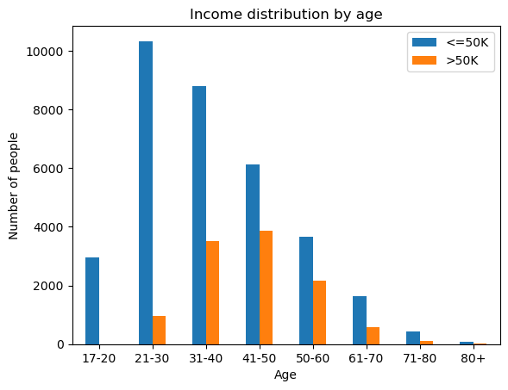
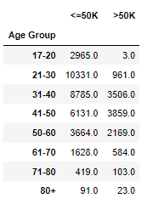
Income distribution by Age
A vast majority of people in the 17-30 age bracket make below 50K.
The highest proportion of people making more than 50K reside in the 41-50 age bracket.

Slide 9
Conclusion
There is significant evidence to conclude that income inequality exists by ethnicity and gender. There is a higher proportion of males making more than 50K compared to females.
Specifically, Asian male demographic have the highest proportion of people making more than 50K while Black female demographic have the lowest proportion of people making more than 50K.
There is evidence to suggest that income distribution varies significantly by age however it can’t be proven that the inequality exists due to discriminatory reasons.

